Slide 1
Teacher Interview Project
By lia gronberg

Slide 2
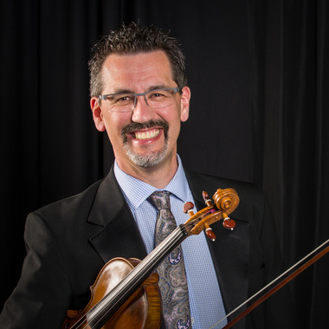
About Calvin Dyck
- Undergraduate degree at Biola University
- Doctorate degree at University of Southern California in Musical Arts for violin performance
- Playing since the age of 8
-Director of the Abbotsford Youth Orchestra
- Concertmaster for the Vancouver Island Symphony Orchestra

Slide 3
My interview with Calvin
Why he became a music teacher
His personal philosophy
How his perspective changed over the years
His goal as a teacher

Slide 4
Why I chose Calvin
Inspired me to pursue music as a career
Motivated me to enjoy all aspects of music
Pushed me to get to my full potential
Great

